Slide 1

Horizon Europe in a nutshell
The content of this presentation is preliminary and may be subject to change

Slide 2
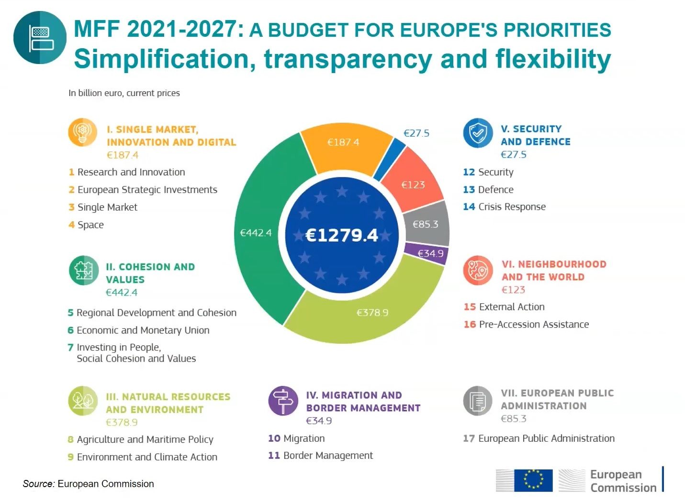
Notes:
Multiannual Financial Framework (MFF) 2021-2027

Slide 3
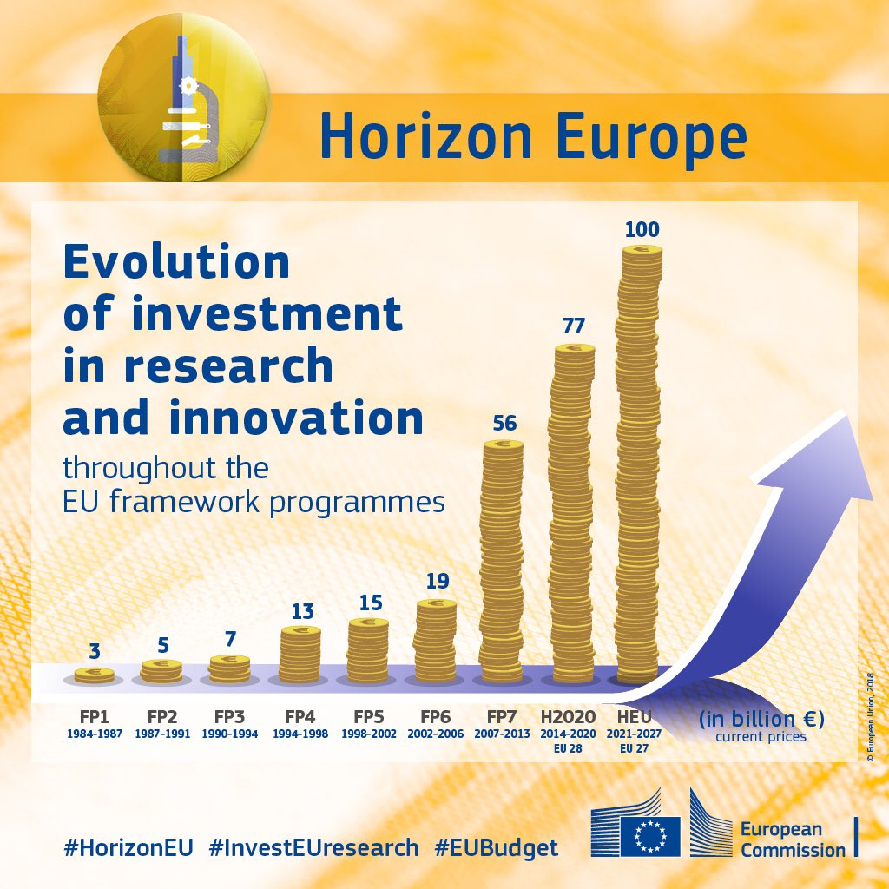
R&D in Europe
The European Union (EU) offers support to R&D projects in form of its
"Framework Programme for Research and Innovation"
With a budget of more than EUR 95 billion for
Horizon Europe, it is the world's largest funding program for research and innovation.
95,5

Slide 4
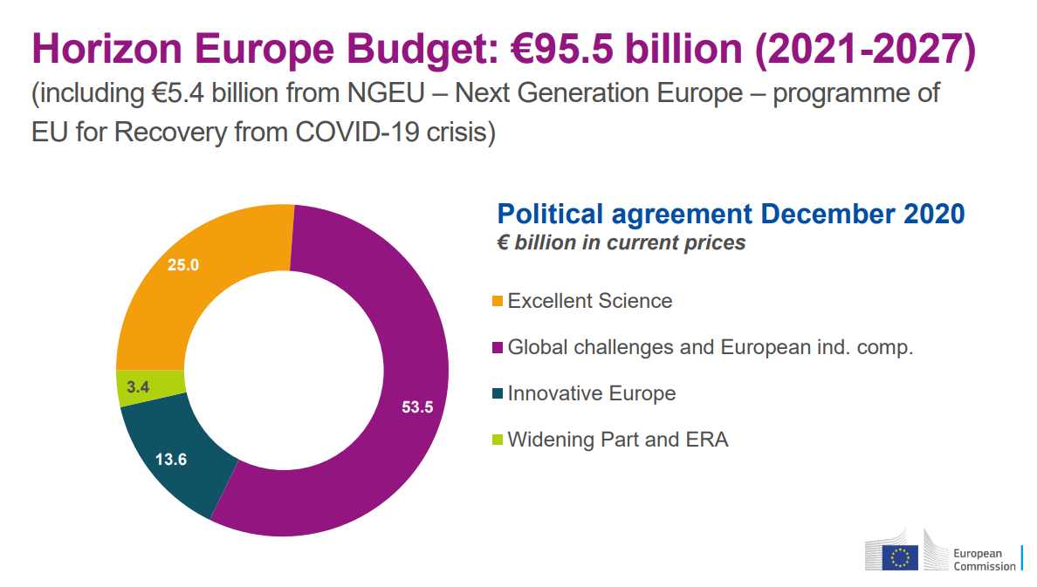

Slide 5
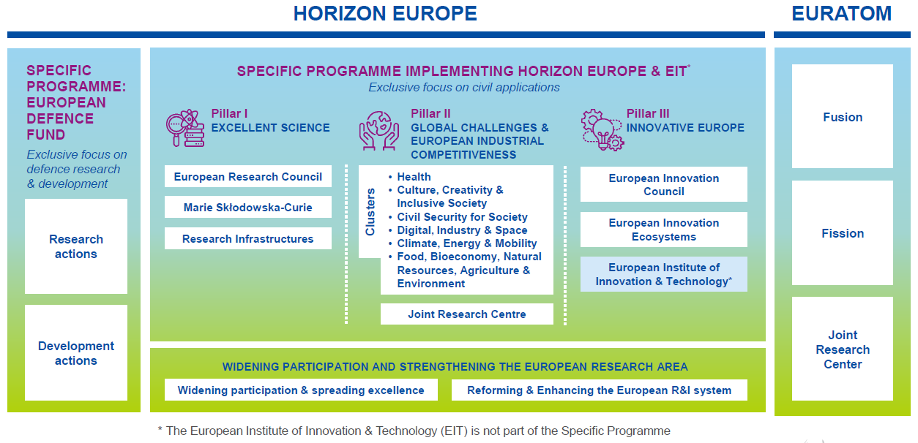
Horizon Europe - Structure
Notes:
Horizon Europe bestaat uit 3 pijlers (pillars) en enkele horizontale acties.
Pijler 1: Excellent Science
De Excellent Science pijler heeft als doel de wetenschap in Europa op topniveau te houden of te brengen. Daarnaast dragen de acties uit deze pijler bij om van Europa een aantrekkelijke locatie te maken voor ’s werelds beste onderzoekers. Europa wil onderzoekstalent aantrekken, ontwikkelen en toegang bieden tot de beste onderzoeksinfrastructuren.
Pijler 2: Global Challenges and European Industrial Competitiveness richt zich op de grote uitdagingen waar de EU en de wereld mee worstelen. Die zijn onder andere benoemd in de Sustainable Development Goals (SDGs).
Brede samenwerking tussen partijen uit verschillende sectoren (onderzoek- en onderwijsinstellingen, industrie, NGOs, en meer) is nodig om de omvang en complexiteit van deze problemen aan te pakken.
Pijler 3: Innovative Europe
De derde pijler van Horizon Europe is gericht op innovatie om het concurrentievermogen van de EU te versterken.
Horizontale acties
Om de Europese Onderzoeksruimte (ERA) te versterken zet Horizon Europe via horizontale acties diverse instrumenten in gericht op verbreding van excellentie in Europa en hervormingen van nationale onderzoeks- en innovatiesystemen.
EURATOM: Budget for years 2021-27= €1.981 billion
Objective
Research and training activities to reduce risks in nuclear safety and security, development of safe nuclear technologies and optimal radiation protection.
Key novelties
●Increased focus on non-power applications of radiation (medical, industrial, space)
●Opening mobility opportunities for nuclear researchers through inclusion in Marie Skłodowska-Curie Actions
EUROPEAN DEFENCE FUND
Het nieuwe EDF zal gezamenlijke acties en grens­overschrijdende samen­werking in de hele EU ondersteunen, en dat in elke fase van de industriële cyclus met betrekking tot defensie­producten en -technologieën. Het programma wordt zo opgezet dat defensie-industrie van ongeacht welke omvang – inclusief kleine en middelgrote ondernemingen en midcap-ondernemingen – uit de hele EU kan deelnemen, hetgeen de toeleverings- en waardeketens op defensiegebied zal versterken en verbeteren.
Voor het eerst zal rekening worden gehouden met ethische overwegingen: acties in het kader van het fonds zullen door de Commissie worden onderworpen aan een ethische beoordeling.
Het fonds zal € 7 953 000 000 (in lopende prijzen) toegewezen krijgen.
Binnen dat budget zal € 2 651 000 000 worden uitgetrokken voor onderzoek en € 5 302 000 000 voor ontwikkelingsacties.
Om de samenhang met het MFK en de daaraan gerelateerde programma's te verzekeren, werd besloten dat het EDF dezelfde looptijd als het MFK krijgt: van 1 januari 2021 tot en met 31 december 2027.

Slide 6
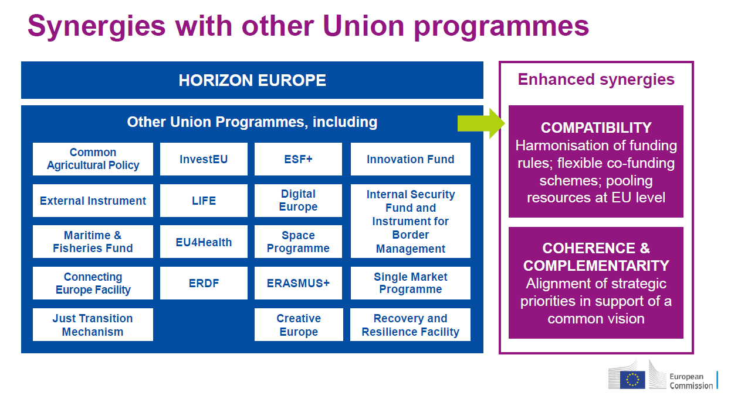
More information on these programmes can be found on www.eufundingoverview.be

Slide 7
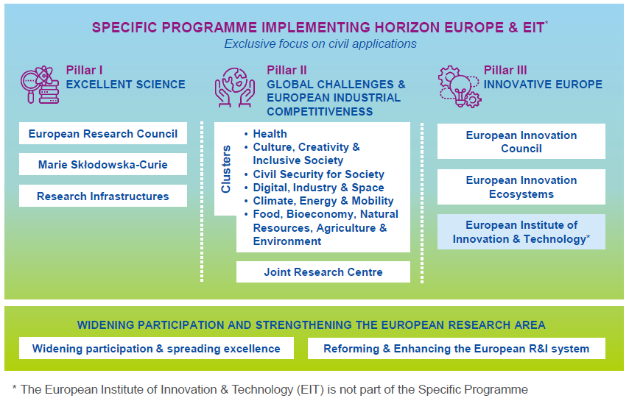
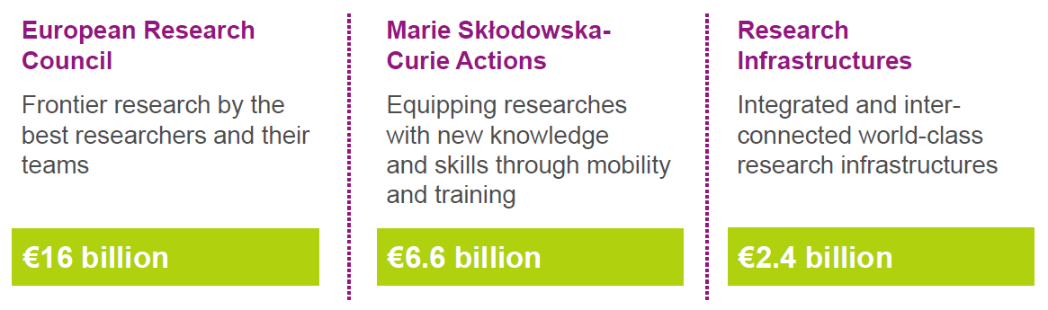
Pillar 1 – Excellent Science
Budget 2021 - 2027
€25bn
Notes:
Pijler 1: Excellent Science
De Excellent Science pijler heeft als doel de wetenschap in Europa op topniveau te houden of te brengen. Daarnaast dragen de acties uit deze pijler bij om van Europa een aantrekkelijke locatie te maken voor ’s werelds beste onderzoekers. Europa wil onderzoekstalent aantrekken, ontwikkelen en toegang bieden tot de beste onderzoeksinfrastructuren.

Slide 8

~€1.897 bn
2021
Pillar 1 – Excellent Science
European Research Council (ERC)
Three calls for proposals in 2021 work programme
  Starting grants
    Researchers with 2-7 years of experience after PhD
    up to € 1.5 M (+€ 1 M)
    up to 5 years
  Consolidator grants
    Researchers with 7-12 years of experience after PhD
    up to € 2 M (+€ 1 M)
    up to 5 years
  Advanced grants
    Researchers with 10-year significant research achievements track-record
    up to € 2.5 M (+€ 1 M)
    up to 5 years

Slide 9
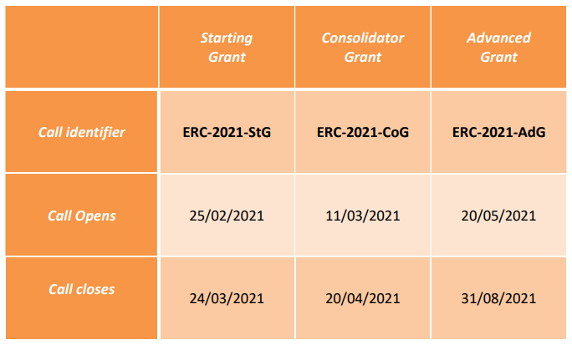
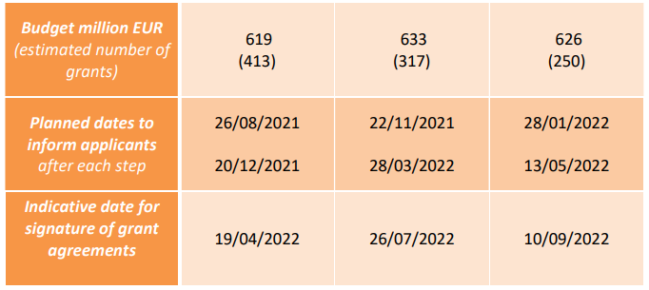
Pillar 1 – Excellent Science
European Research Council (ERC)
Source: ERC work programme 2021

Slide 10

~€1.66 bn
2021/22
Pillar 1 – Excellent Science
Marie Skłodowska-Curie Actions (MSCA)
Five actions under 2021-2022 work programme
  Doctoral Networks: networks training doctoral candidates, in and outside academia
  Postdoctoral Fellowships: support to postdoctoral researchers
  Staff Exchanges: support to any type of research (-related) staff
  Cofund: co-funding doctoral and postdoctoral training programmes
  MSCA and Citizens: public outreach events

Slide 11
~€587M
2021/22
Pillar 1 – Excellent Science
Research Infrastructures (RI)
Five destinations under 2021-2022 work programme
  Developing, consolidating and optimising European RIs landscape, maintaining global leadership (3 calls, 8 topics)
  Enabling an operational, open and FAIR EOSC system (2 calls, 11 topics)
  RI services to support health research, accelerate the green and digital transformation, and advance frontier knowledge (3 calls, 9 topics)
  Next generation of scientific instrumentation, tools and methods and advanced digital solutions (2 calls, 2 topics)
  Network connectivity in Research and Education – Enabling collaboration without boundaries (1 call, 1 topic)
  Other actions not subject to calls for proposals

Slide 12
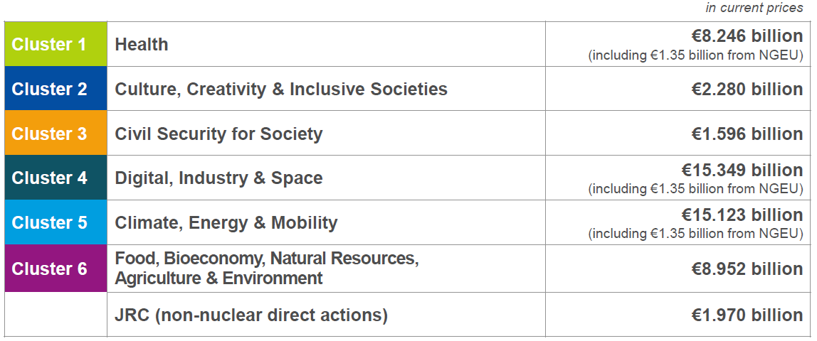
Pillar 2 – Global Challenges and European Industrial Competitivness
Budget 2021 - 2027
€53.5bn
Notes:
Pijler 2 richt zich op de grote uitdagingen waar de EU en de wereld mee worstelen. Die zijn onder andere benoemd in de Sustainable Development Goals (SDGs).
Brede samenwerking tussen partijen uit verschillende sectoren (onderzoek- en onderwijsinstellingen, industrie, NGOs, en meer) is nodig om de omvang en complexiteit van deze problemen aan te pakken. Denk daarbij aan gezondheid en welzijn voor iedereen, een digitale economie, oplossingen voor klimaatveranderingen, transitie naar een circulaire economie en het voedselprobleem. Dat alles moet ook leiden tot een sterke Europese industriesector en meer werkgelegenheid.
Activiteiten binnen pijler 2 zijn gericht op excellentie en maatschappelijke impact. Aanvragers binnen deze pijler zijn vaak consortia van meerdere publieke en private partijen (onderzoekers van universiteiten en bedrijven, fabrikanten, eindgebruikers, etc.). Alle betrokken partijen brengen via multidisciplinaire samenwerking zowel inhoudelijke als technologische kennis bij elkaar.
Het Joint Research Centre (JRC) is in pijler 2 ondergebracht. Het JRC is de interne wetenschappelijke dienst van de EC, die de beleidsvorming van de EU ondersteunt met onafhankelijk, goed onderbouwd wetenschappelijk advies.

Slide 13
~€1.87 bn
2021/22
Pillar 2 – Cluster 1 - Health
Aim
To promote and protect human health and well-being,
Prevent diseases and decrease the burden of diseases and disabilities on people and communities,
Support the transformation of health care systems
Foster an innovative, sustainable and globally competitive European health industry
Union policy priorities
Healthy citizens in a rapidly changing society
Healthy and health-promoting living and working environments;
Effective health services to tackle diseases and reduce the burden of diseases;
Improved access to innovative, sustainable and high-quality health care
Unlocking the full potential of new tools, technologies and digital solutions for a healthy society
A sustainable and globally competitive health-related EU industry
Topics
“Health throughout the life course”, including matters such as healthy ageing, infant and child health, and mental health in adolescents
“Environmental and social health determinants” like pollution, poverty, and occupational health
“Non-communicable and rare diseases”
“Infectious diseases, including poverty-related and neglected diseases”
“Tools, technologies and digital solutions for health and care, including personalised medicine”
“Health care systems” addressing how public health services
Notes:
Zomer 2019 = start met opzet Strategic Plan -> Workprogramme -> calls -> call topics

Slide 14
Pillar 2 – Cluster 2 - Culture, Creativity and Inclusive Society
~€0.42 bn
2021/22
Aim
To enhance democratic governance and citizens participation,
To Safeguard and promote cultural heritage,
To respond to social, economic, technological and cultural transformations.
Expand civic engagement, boosting transparency, accountability, inclusiveness and legitimacy of governance, improving levels of trust and tackling political extremism.
Promote better access and engagement with cultural heritage and improve its protection, enhancement and restoration.
Union policy priorities
Enhanced democracy and governance
Better approaches to tackling political extremism and polarisation
Reversing socio-economic and gender inequalities
Improved understanding of societal -including political, ethical and economic - effects of technological advancements and the impact of drivers of change
A novel growth model
Increased use of evidence-based strategies in the management of mobility and migration and the integration of migrants in European society;
Better valorisation of European cultural heritage
Topics
“Democracy and governance,” including populism, journalistic standards, cultural identity, social media, and justice systems
“Cultural heritage” and the Cultural and Creative Industries
“Social and economic transformations” including education and training, sustainability, tax and social security, and affordable housing
2021 calls
opening 15th April 2021
deadline 1st Sept 2021
2022 calls
opening 20th Jan 2022
deadline 20th April 2022

Slide 15
~€0.4 bn
2021/22
Pillar 2 – Cluster 3 - Civil security for Society
Aim
To protect the EU and its citizens from the threats posed by crime and terrorism (including in the cyber environment) and from the impacts of natural and man-made disasters.
Union policy priorities
Improved disaster risk management and societal resilience
Improved management of EU external borders
Better protection of public spaces
Improved security and resilience of infrastructure and vital societal functions
Improved maritime security
More effective fight against crime and terrorism
Increased cybersecurity
Topics
“Disaster-resilient societies” including tools for first responders and tools to prevent, manage and reduce disaster risk
“Protection and security” including tools for emergency services, analysis of crossbordercrime, radicalisation and fraud
“Cybersecurity”
2021 calls
opening 15th April 2021
deadline 8th Sept 2021
2022 calls
opening 15th March 2022
deadline 8th Sept 2022

Slide 16
~€3.4 bn
2021/22
Pillar 2 – Cluster 4 - Digital, Industry and Space
Aim
To advance key enabling, digital and space technologies, underpinning the transformation of our economy and society,
To support the digitisation and transformation of European industry
To contribute to growing a low-carbon, circular and clean industry
To address the challenges European industry is facing
Union policy priorities
More appealing and creative jobs in Europe
Increased autonomy in critical raw materials
Increased industrial leadership in key enabling and digital technologies and uptake of new technologies
Climate-neutral, circular and clean EU industries
Increased inclusiveness
Topics
“Manufacturing technologies” such as biotech production, additive manufacturing, intelligent robotics, AI, sensor technologies, advanced batteries and hydrogen
“Key digital technologies,” such as nanoelectronics and photonics
“Emerging enabling technologies”
“Advanced materials”
“Artificial intelligence and robotics”
“Next Generation Internet”, 5G and the services they might support,
“Advanced Computing and Big Data” including High Performance Computing (HPC)
“Circular Industries,”
“Low-carbon and clean industries” including process technologies, conversion technologies, electrification and unconventional energy sources within industrial plants
“Space, including Earth Observation,” including satellite programmes like Galileo, EGNOS and Copernicus; Space Situational Awareness, secure satellite comms
2021 calls
opening 15th April 2021 and May 6th deadlines 15th July, + 7, 8 and 29th Sept 2021

Slide 17
~€2.8 bn
2021/22
Pillar 2 – Cluster 5 - Climate, Energy and Mobility
Aim
To fight climate change while improving the competitiveness of the energy and transport industries as well as the quality of the services that these sectors bring to society.
Establishing a better understanding of the causes, evolution, risks, impacts and opportunities of climate change,
Making energy and mobility systems more climate-and environment-friendly, smarter, safer, and more resilient, inclusive, competitive and efficient.
Union policy priorities
Contribute to developing low-carbon and competitive transport solutions across all modes
Advanced climate science and solutions;
Novel competitive cross-sectoral solutions for decarbonisation
A novel energy system
New demand side solutions to decarbonise the energy and transport systems
Reduction of greenhouse gas emissions;
Increased adaptation of production systems
Reinforced bio-economy
Topics
“Climate science and solutions”
“Energy supply”
“Energy systems and grids”
“Buildings and industrial facilities in energy transition”
“Communities and cities,” including decarbonisation, urban planning, and quality of lifeforcitizens
“Industrial competitiveness in transport,” including vehicle design and on-board systems, as well as new materials and construction methods
“Clean, safe and accessible transport and mobility” including electrification of all modes of transport, batteries, fuel cells, and hybrid fuel technologies, sustainable fuels, and analysis of mobility patterns
“Smart mobility” including digital traffic management, air traffic control, railway automation, and smart shipping,
“Energy storage” including liquid and gaseous renewable fuels, batteries, and hydrogen
2021 calls
opening 15th April 2021
deadlines 26th Aug, 7th Sept 2021 and 19th October 2021

Slide 18
~€1.7 bn 2021/22
Pillar 2 – Cluster 6 – Food, Bio-economy, Natural Resources,
Agriculture and Environment
Aim
To advance knowledge, expand capacities and deliver innovative solutions to accelerate the transition towards the sustainable management of natural resources
reversing biodiversity decline;
reducing environmental degradation and pollution
Union policy priorities
Reduction of greenhouse gas emissions and successful adaptation
Halt of biodiversity decline and restoration of ecosystems;
Sustainable and circular management and use of natural resources;
Establishment of new primary production, food and bio-based systems based on sustainability
Behavioural, socio-economic and demographic change are well understood
Establishment of new governance models enabling sustainability.
Topics
“Environmental observation” including open data, monitoring of biodiversity, and the Global Earth Observation System of Systems of the Group of Earth Observations
“Biodiversity and natural resources” including terrestrial, freshwater and marine ecosystems and ecotoxicology of compounds and new pollutants
“Agriculture, forestry, and rural areas,” including antimicrobial resistance and agrochemical hazards, as well as digital innovations in farming and forestry such as AI, robotics, precision farming and remote sensing
“Seas, oceans and inland waters” including environmental protection, the blue economy, and the role of seas in migration
“Food systems” including healthy diets, personalised nutrition for vulnerable groups, consumer behaviour, and environmental sustainability
“Bio-based innovation systems in the EU bioeconomy,” including sustainable biomass sourcing and bio-based materials
“Circular systems” including cities and the use of water resources”
2021 calls
opening 15th April 2021
deadline 1st Sept 2021
2022 calls
opening 28th October 2021
deadline 15th Feb 2022

Slide 19
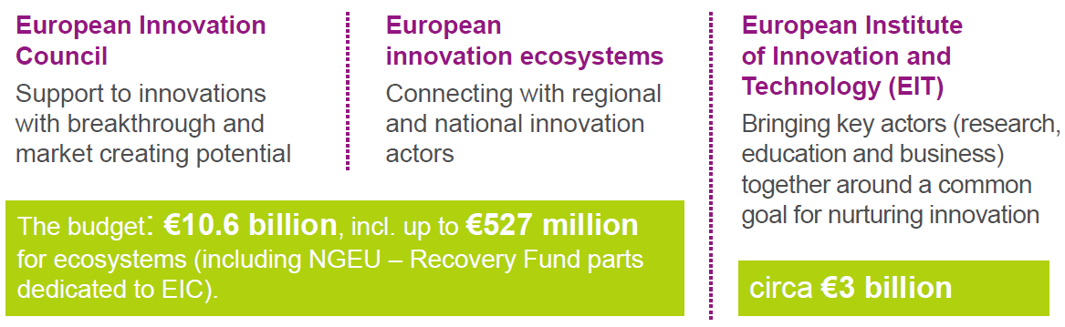
Pillar 3 – Innovative Europe
Budget 2021 - 2027
€13.6bn
Notes:
Pijler 3: Innovative Europe
De derde pijler van Horizon Europe is gericht op innovatie om het concurrentievermogen van de EU te versterken.
De pijler is ingevuld met de European Innovation Council (EIC).
De EIC richt zich voornamelijk op individuele innovatieve bedrijven en zal primair bestaan uit 2 onderdelen:
- De Pathfinder voor innovaties met een laag technology readiness level (TRL)
- De Accelerator voor innovaties met een hoog TRL. Daarbij worden mogelijkheden geboden voor het combineren van diverse vormen van financiering, waaronder ook investering in vermogen (equity).
Het nieuwe onderdeel in pijler 3 is European Innovation Ecosytems. Dit onderdeel is gericht op het opbouwen en versterken van ecosystemen en zal regionale en nationale innovatie-actoren met elkaar verbinden.
Ook het Europees Instituut voor innovatie en technologie (EIT) wordt ondergebracht onder de derde pijler van Horizon Europe. Dit is een EU-orgaan dat in 2008 door de Europese Unie is opgericht om het innovatievermogen van Europa te versterken. Het EIT stimuleert innovatie in heel Europa door bedrijven, onderwijs en onderzoek te integreren om oplossingen te vinden voor urgente wereldwijde uitdagingen.

Slide 20

~€1.55 bn
2021/22
Pillar 3 – Innovative Europe
European Innovation Council (EIC)
Calls for proposals in 2021 work programme:
Pathfinder (TRL 1 up to 4)
  Open call
  Challenge driven call (5 topics)
Transition (TRL 4 to 5/6)
  Open call
  Challenge driven call (2 topics)
Accelerator (TRL 5 up to 8)
  Open call
  Challenge driven call (2 topics)
  4 prizes: EU Prize for Women Innovators, The European Capital of Innovation Awards, the European Innovation Procurement Awards, The European Social Innovation Competition

Slide 21
Pillar 3 – Innovative Europe
European Innovation Council (EIC)
Technology Readiness Levels (TRLs)
              TRL1 - basic principles observed
              TRL2 - technology concept formulated
              TRL3 - experimental proof of concept
              TRL4 - technology validated in lab
              TRL5 - technology validated in relevant environment
              TRL6 - technology demonstrated in relevant environment
              TRL7 - system prototype demonstration in operational environment
              TRL8 - system complete and qualified
              TRL9 - actual system proven in operational environment
PATHFINDER
TRANSITION
ACCELERATOR

Slide 22
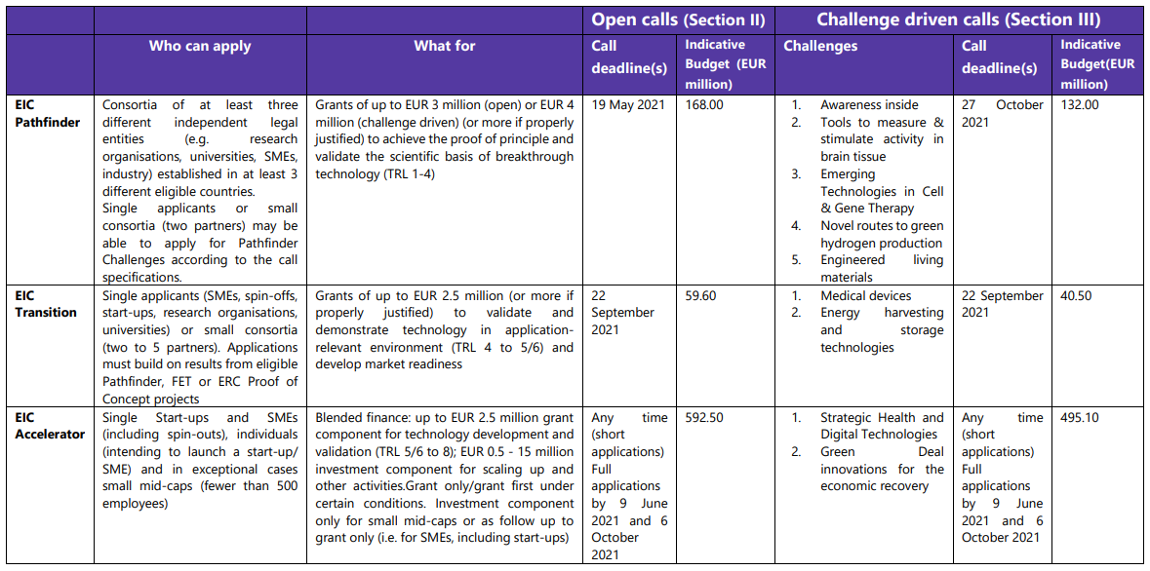
Pillar 3 – Innovative Europe
European Innovation Council (EIC)
Source: EIC
work
programme
2021

Slide 23
~€128 M
2021/22
Pillar 3 – Innovative Europe
European Innovation Ecosystems (EIE)
Aim to create more connected, inclusive and efficient innovation ecosystems
These ecosystems should
  Support the scaling up of companies
  Support cooperation to develop innovative solutions
  Address solutions necessary for social and economic recovery, environmental sustainability and resilience
  Three destinations
  Connect – Interconnected Innovation Ecosystems (3 calls, 6 topics)
  Scaleup – Elevating the scalability potential of European business (3 calls, 5 topics)
  Innovsmes – Partnership on Innovative SMEs (1 call, 1 topic)

Slide 24

~€400 M
2021
Pillar 3 – Innovative Europe
European Institute of Innovation and Technology (EIT)
Knowledge and Innovation Communities (KICs) are partnerships that bring together businesses, research centres and universities. Activities cover the entire innovation chain.
  EIT Climate-KIC: Drivers of climate innovation in Europe and beyond
  EIT Digital: For a strong, digital Europe
  EIT Food: EIT Food connects businesses, research centres, universities and consumers
  EIT InnoEnergy: Pioneering change in sustainable energy
  EIT Health: Together for healthy lives in Europe
  EIT Manufacturing: Strengthening and increasing the competiveness of Europe's manufacturing
  EIT Raw Materials: Developing raw materials into a major strength for Europe
  EIT Urban Mobility: Smart, green and integrated transport
  -> The launch of two new KICs foreseen in 2022 (cultural and creative sectors and industries CCI) and 2026 (water, marine and maritime sectors and ecosystems).

Slide 25
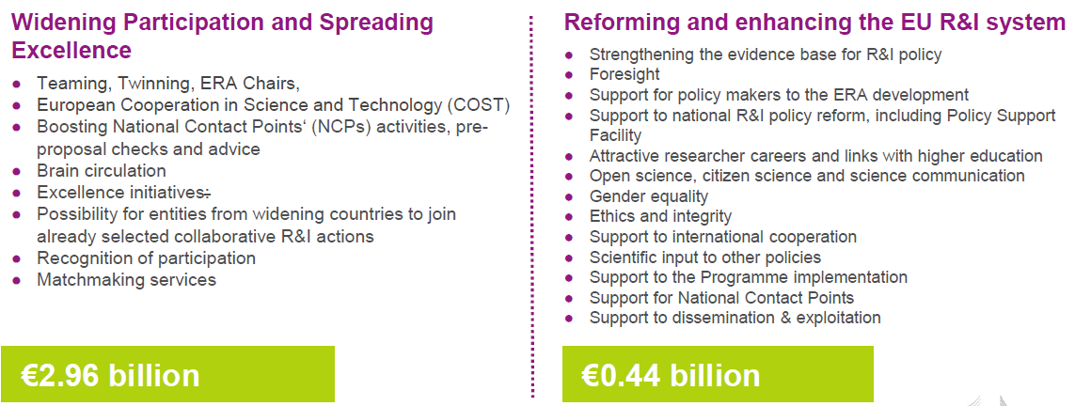
Widening Participation and Strengthening the European Research Area
Budget 2021 - 2027
€3.4bn
Notes:
Horizontale acties
Om de Europese Onderzoeksruimte (ERA) te versterken zet Horizon Europe via horizontale acties diverse instrumenten in gericht op verbreding van excellentie in Europa en hervormingen van nationale onderzoeks- en innovatiesystemen.
Voorbeelden van deze instrumenten zijn Teaming, Twinning en European Cooperation in Science and Technology (COST).

Slide 26
~€935 M
2021/22
Horizontal – Widening participation and Strengthening the
European Research Area (ERA)
Widening Participation and Spreading Excellence
  Teaming and Twinning
  ERA Chairs
  COST
  Support to NCPs
  Brain circulation and excellence initiatives
  “Hop-on”
  Reforming and Enhancing the European R&I System
    Scientific evidence and foresight
    Open Science
    Policy Support Facility
    Attractive Researcher Careers
    Citizen Science, Responsible Research and Innovation

Slide 27
Horizon Europe – Types of Actions
  Eligibility: any legal entity can participate
    Collaborative projects: Must be a consortium of minimum 3 independent legal entities, each established in a different EU Member State (MS) or Associated Countries (AC), with at least one of them established in a MS.
    Monobeneficiary projects: Coordination and support actions, some ERC, MSCA and co-fund actions
  Main types of action:
    RIA – Research and Innovation Actions – up top 100% funding rate
    IA – Innovation Actions – up to 70% funding rate (except for non-profit legal entities, where
    a rate of up to 100% applies)
    CSA – Coordination and Support Actions – up to 100% funding rate
    Other actions: co-fund, Innovation and Market Deployment (IMDA), Training and Mobility Action
    (TMA), Pre-Commercial Procurement (PCP), Public Procurement of Innovative solutions action (PPI)

Slide 28
Horizon Europe – Evaluation criteria
    Keep in mind the three main evaluation criteria while writing:
    EXCELLENCE (section 1 of proposal template)
    IMPACT (section 2)
    Quality and Efficiency of IMPLEMENTATION (‘excluded’ first stage proposals) (section 3)

Slide 29
Horizon Europe – Proposal template
    Submit your proposal - on time - via the Funding and Tender portal of the European Commission
    Using the proposal template
    Part A = Administrative
    Part B = Technical
      Excellence, impact, implementation
      Under implementation: list of work packages and description, list of deliverables, milestones, risks, staff effort, justification of costs: subcontracting, purchase costs and other cost categories
    Proposal template for Horizon Europe RIA-IA-CSA available

Slide 30
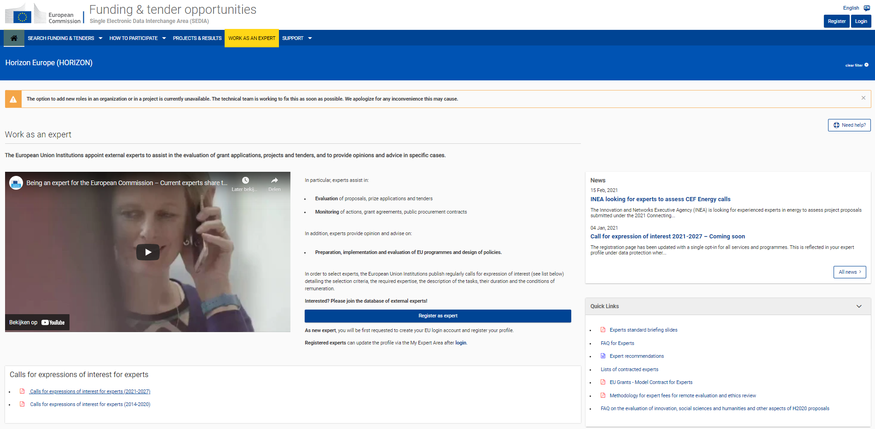
Horizon Europe – Evaluators

Slide 31
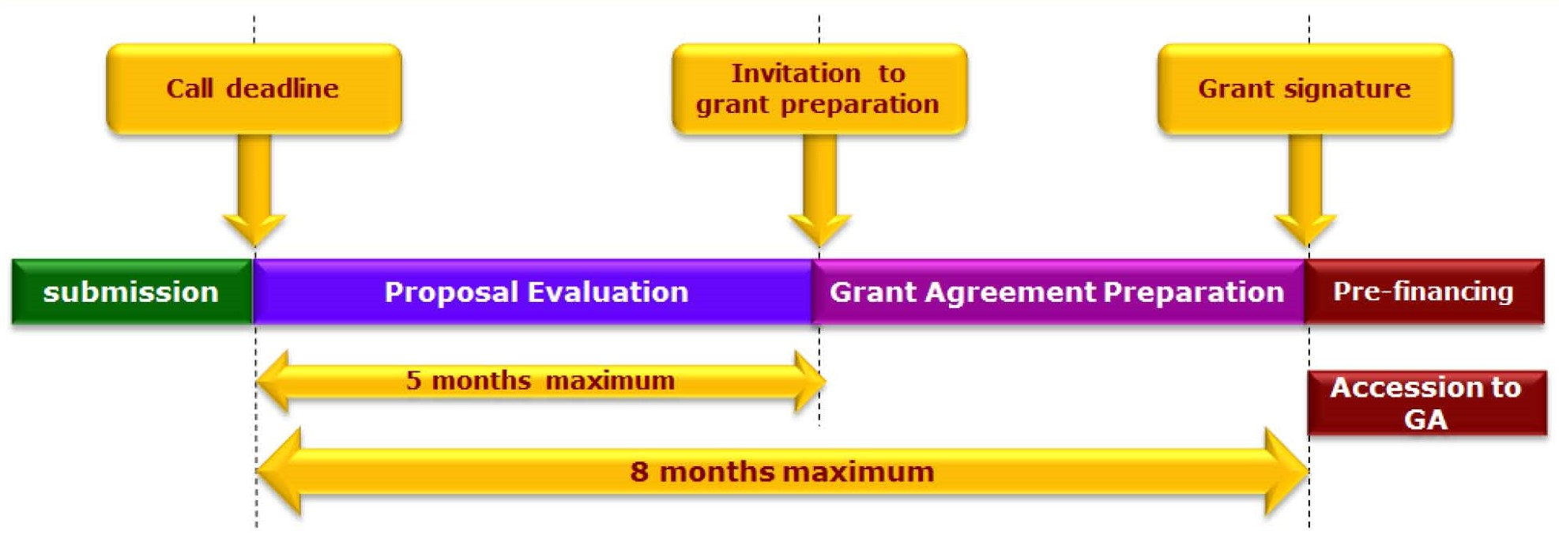
Horizon Europe – Time to Grant (single stage)
  Many exceptions: Always consult the work programme and call documents

Slide 32
Horizon Europe – Open Science
  Open Science is a priority across the programme
  Aim of Open Science: better dissemination and exploitation of R&I results and support to active engagement of society
  New: open access publishing platform launched by European Commission Open Research Europe
  Research data management
  Research Data Management plan obligatory
  Manage data in line with FAIR principles
  Principle “as open as possible, as closed as necessary”, exceptions to open access to research data in case it is:
    Against beneficiary’s legitimate interests
    Contrary to any other constraints

Slide 33
Horizon Europe – Gender Equality
Gender equality is a priority across the programme
New in Horizon Europe: eligibility criterion Gender Equality plans
For whom?
  Public bodies, research organisations and higher education establishments, from EU Member States and Associated Countries
From when?
  Horizon Europe calls with a deadline in 2022
What?
  Mandatory process-related elements: a formal public document, dedicated resources, data collection and monitoring, training and capacity building
  Recommended areas to be covered:
    Work-life balance and organisational culture
    Gender balance in leadership and decision-making
    Gender equality in recruitment and career progression
    Integration of the gender dimension into research and teaching content
    Measures against gender-based violence including sexual harassment
    Useful resources
  European Commission, DG R&I strategy Gender equality in research and innovation
  DG R&I Horizon Europe gender equality fact sheet

Slide 34
Horizon Europe – Simple rationale for funding
A single set of rules
  adapted for the whole research and innovation cycle
  coherent with all other EU Programmes
Simple rules for grants
  Budget
    Cost categories A->D (in the example personnel cost + purchase cost)
    Increased with 25% flat rate for indirect costs
  Funding rates
    RIA/CSA = 100% for all partners
    IA = 70% (profit)/ 100% (non-profit)
Few, well-targeted controls and audits
Example
Personnel costs
2 PY = 150 kEUR
Purchase costs
- Travel: 12 kEUR
Consumables: 8 kEUR
Other: 10 kEUR
Indirect costs
25% flat fee: 45 kEUR
BUDGET: 225 kEUR
FUNDING:
RIA/CSA: 225 kEUR
IA: 157,5 kEUR

Slide 35
European Partnerships

Slide 36
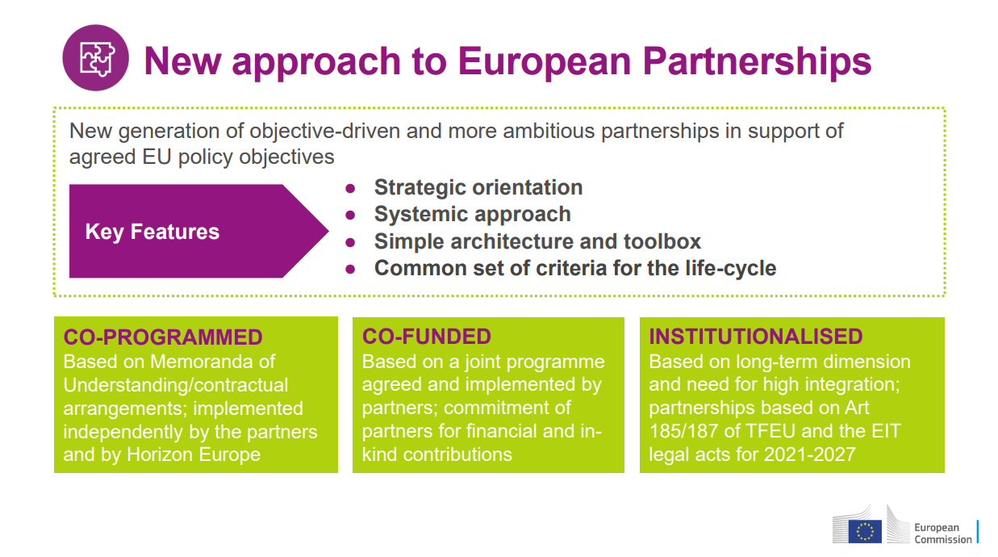
Notes:
European Partnerships bring the European Commission and private and/or public partners together to address some of Europe’s most pressing challenges through concerted research and innovation initiatives. They are a key implementation tool of Horizon Europe and contribute significantly to achieving the EU’s political priorities.
By bringing private and public partners together, European Partnerships help to avoid the duplication of investments and contribute to reducing the fragmentation of the research and innovation landscape in the EU.

Slide 37
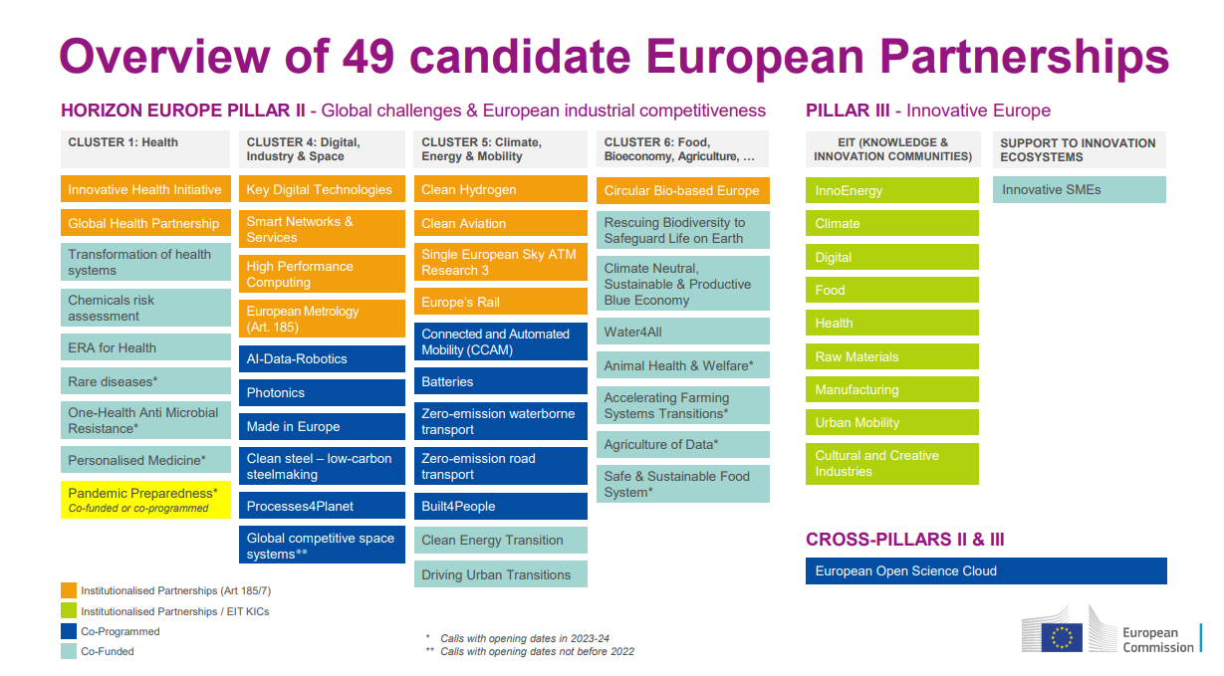

Slide 38
Missions

Slide 39
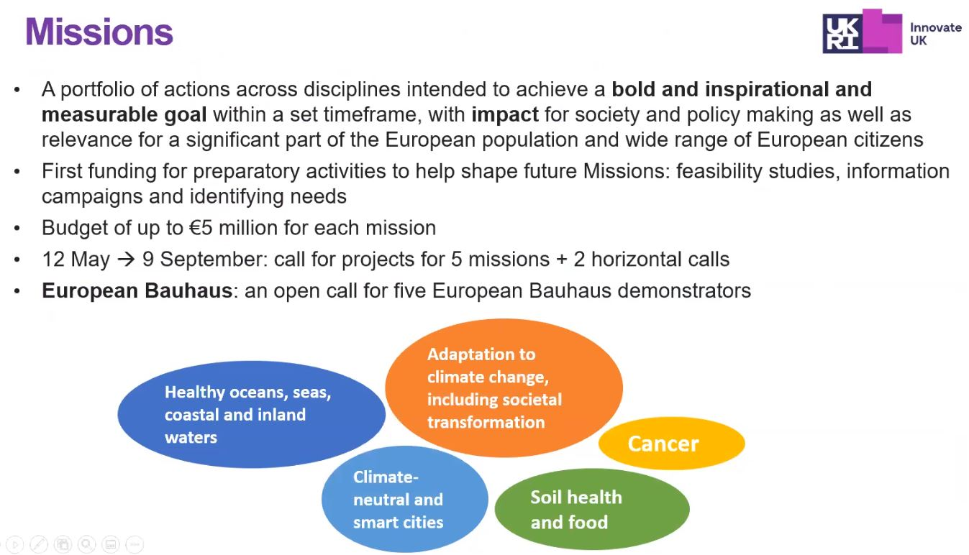
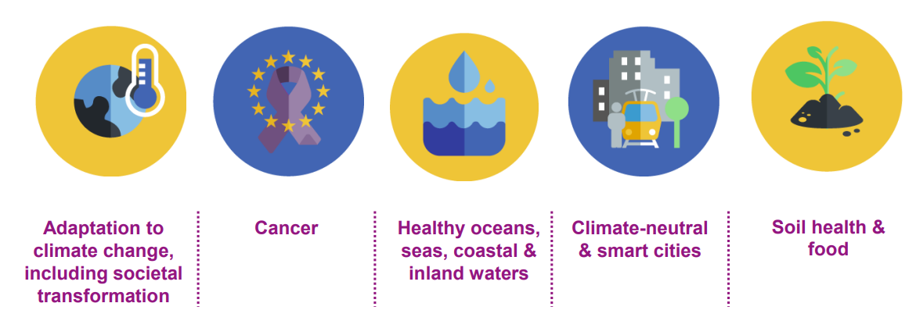

Slide 40
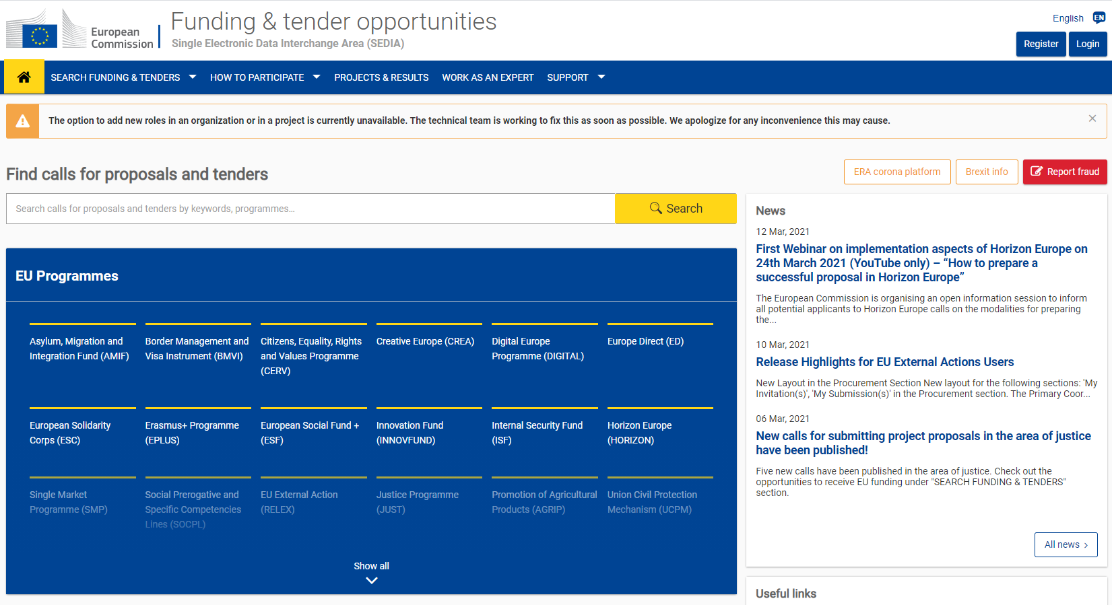
Funding & Tender portal: https://ec.europa.eu/info/funding-tenders/opportunities/portal/screen/home

Slide 41
More detailed information
Webinar of the European Commission – "How to prepare a succesful proposal in Horizon Europe" (24 March 2021): presentations and video available on-line
Upcoming webinars by the Commission
  Submission, evaluation and horizontal aspects: 21 April
  Thematic info days per cluster: end of April-May
  EU R&I days: 23-24 June
Information sessions by NCP Flanders
Check NCP Flanders website and register to receive notifications (myHORIZON): www.ncpflanders.be

Slide 42
Horizon Europe
Services NCP Flanders
Partner search services E.E.N.

Slide 43

NCP - Services
Circulate info, promotional activities
Informing
Awareness raising
Advising
Training
Signposting
Assisting
To other BU-networks, national funding
HEU and if needed other RTD
NCP
Researchers/
Organisations - new actors & SME’s, partner search using network (EEN!)
To intermediaries, target groups, on topics
Administration, Appropr. Mgmt, modalities of funding schemes
Minimum standards and Guiding principles for setting up systems of National Contact Points (NCP systems) under Horizon Europe (to be published)

Slide 44
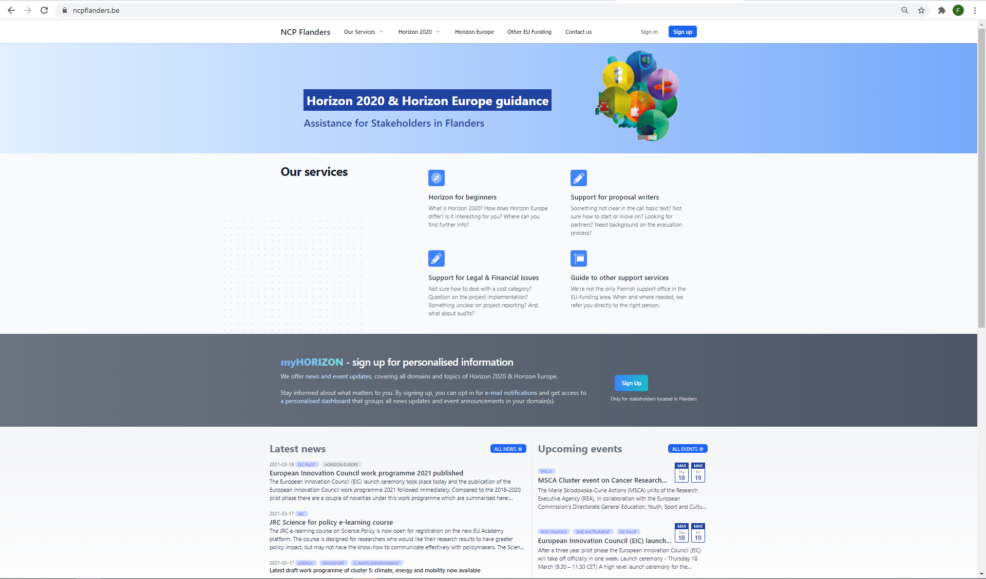
NCP Flanders – www.ncpflanders.be
Direct questions ?
–> contact the specific advisor

Slide 45
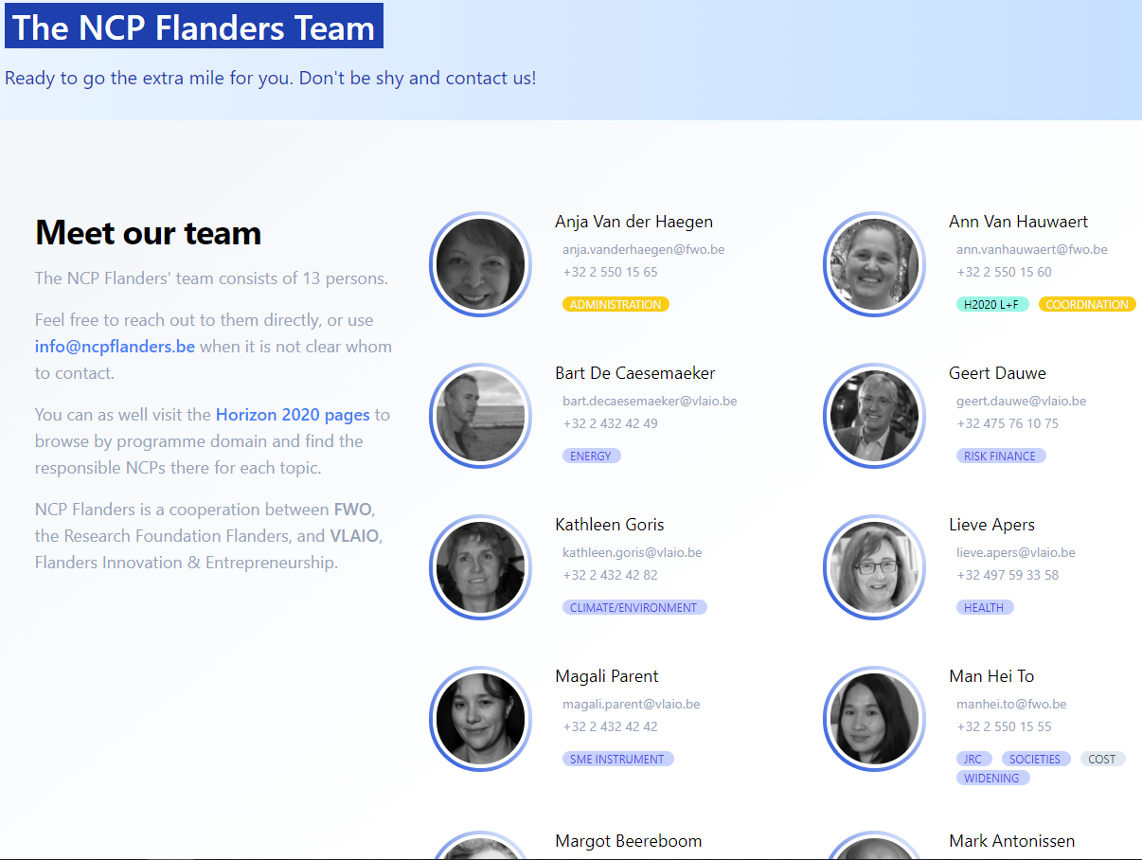

Slide 46
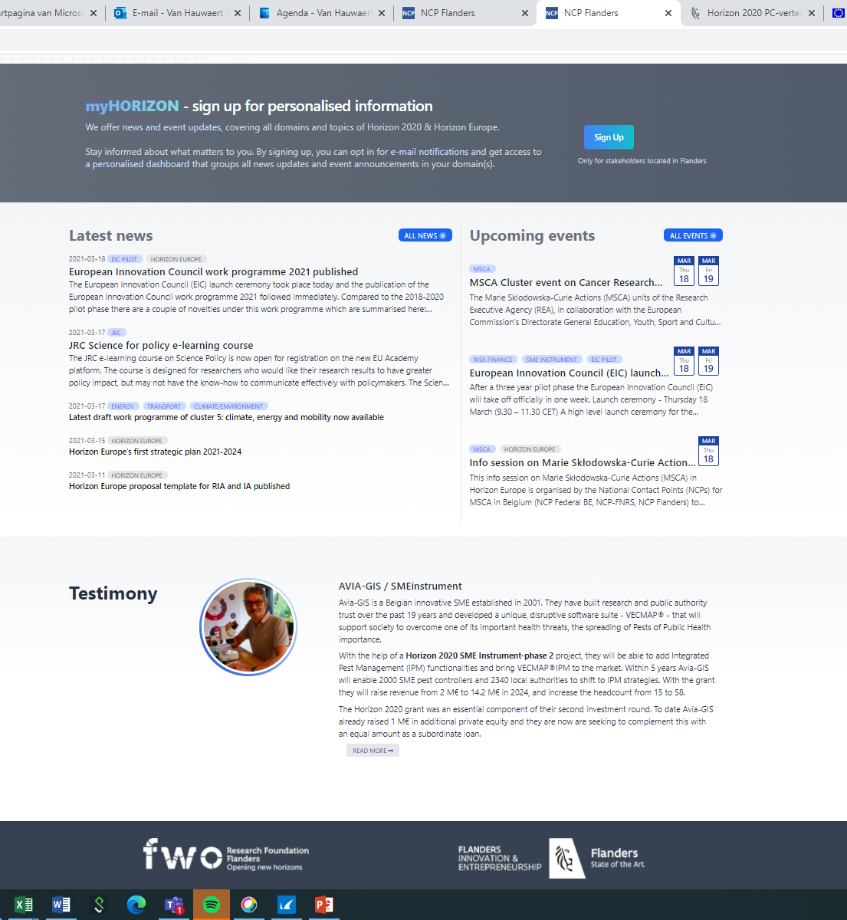
News and Events
myHORIZON
-> sign-up for personalised information
(cfr. home page button)
-> mailings about interesting information,
NCP Flanders events, Commission events, ….

Slide 47
Other related services regarding Horizon Europe
European Liaison Officers of your academic organisation
Interested in strategic dimension – contact Programme Committee delegates of Department of Economy, Science and Innovation
Interested to be connected to international – mainly business- partners – contact E.E.N.
https://ncpflanders.be/our-services/other-support-services

Slide 48
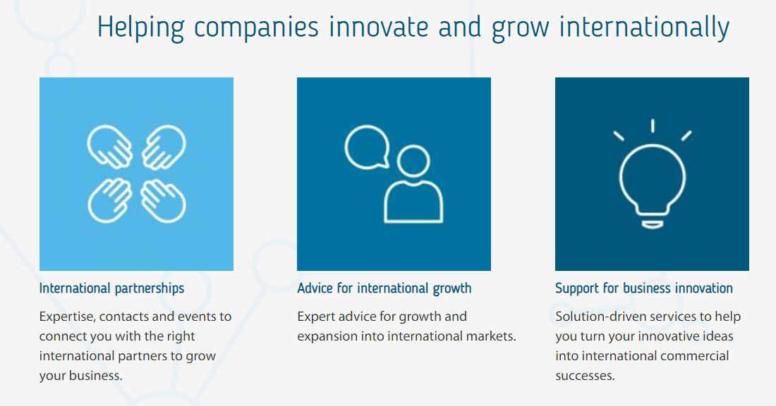
Partner search service
Enterprise Europe Network - https://een.ec.europa.eu/

Slide 49
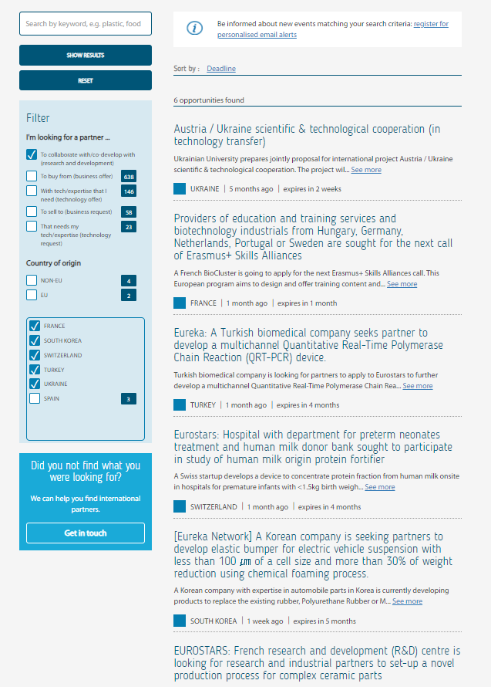
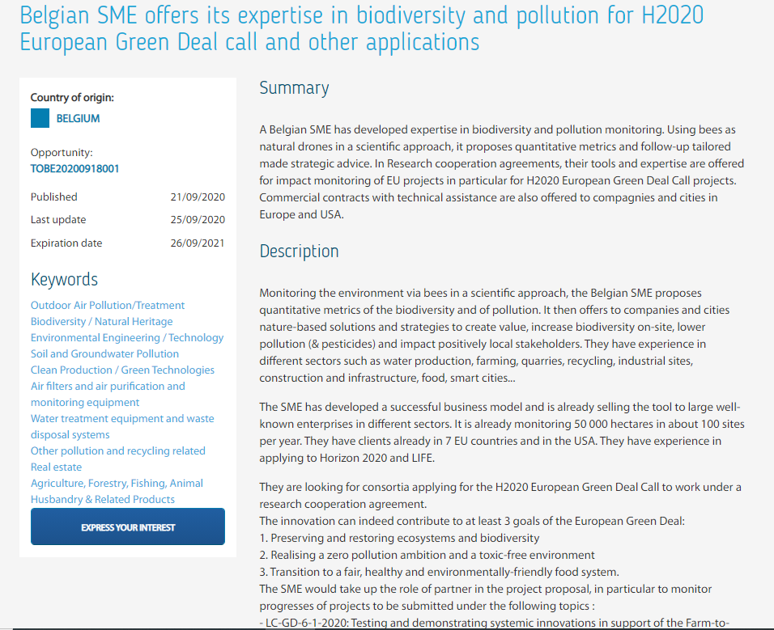
Partner search - Youtube
Database​: https://een.ec.europa.eu/partners
Registration and queries​
Your own profile

Slide 50
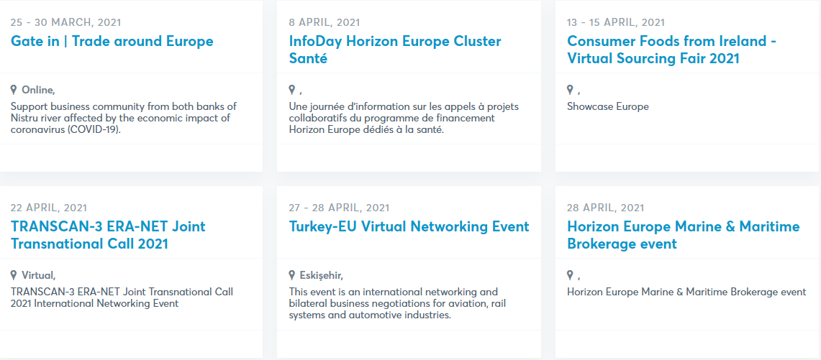
Matchmaking events
Overzichten
  Vlaanderen
  Internationaal
  B2Match

Slide 51
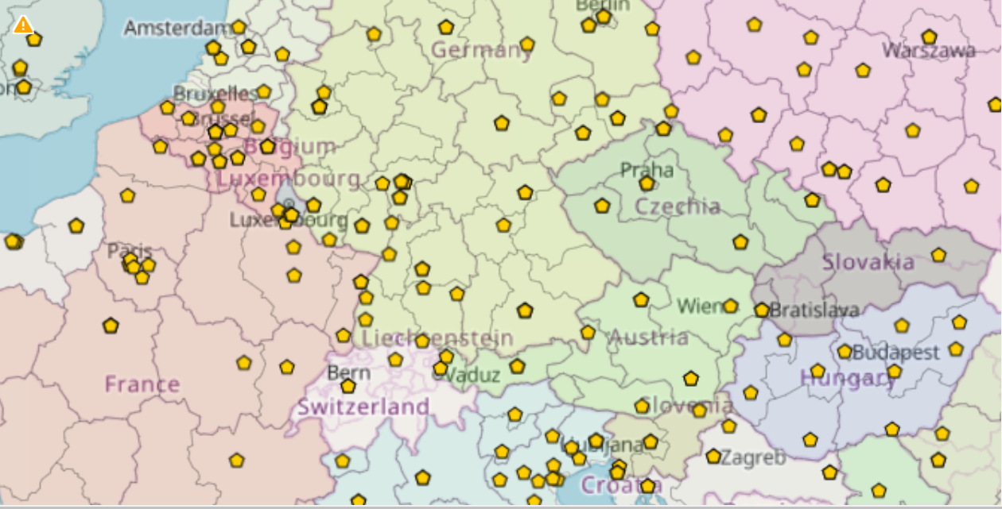

Slide 52
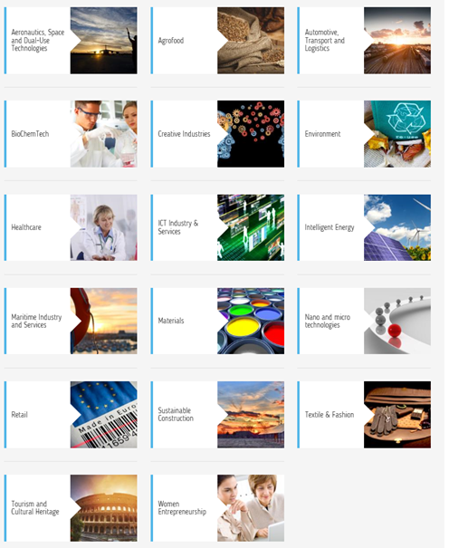
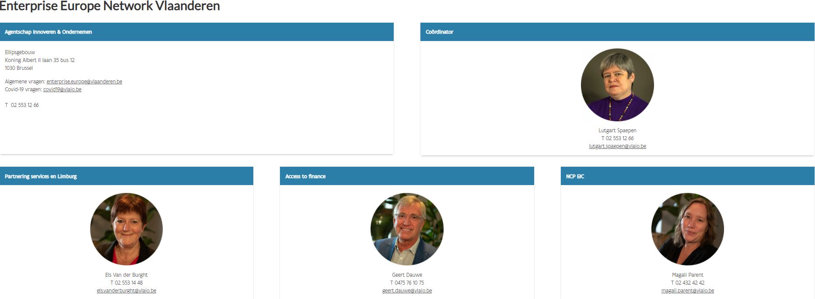
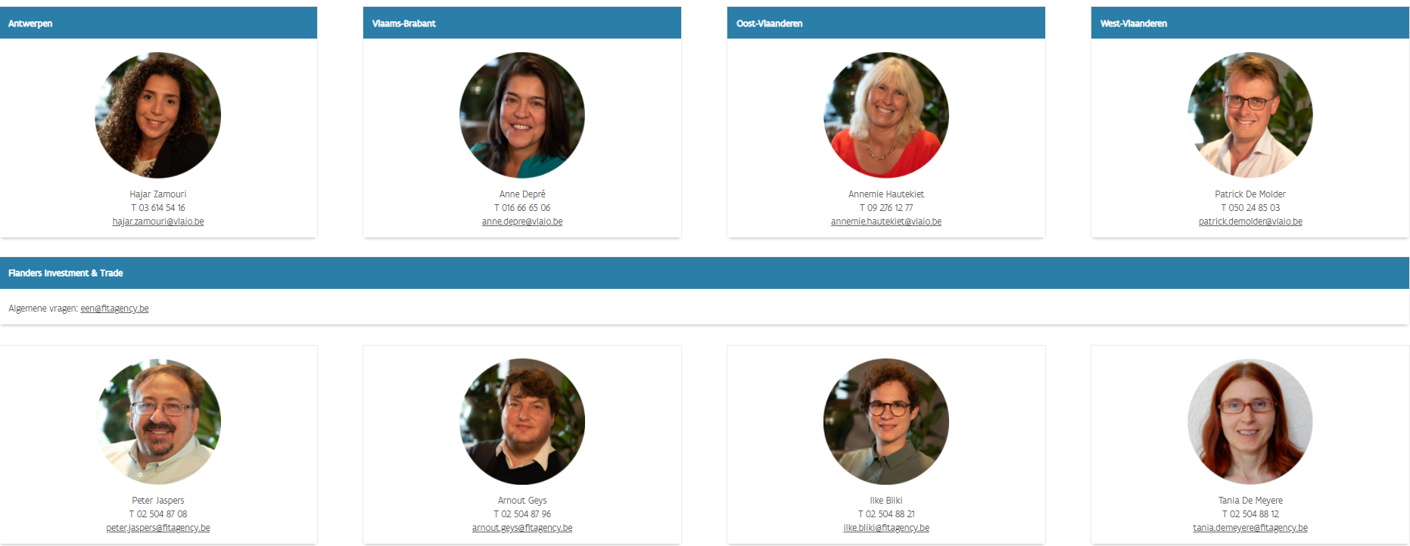
https://www.enterpriseeuropevlaanderen.be/contact

Slide 53
Do not hesitate to contact us!
www.ncpflanders.be/team

