Slide 1
2024 Assessment of Lump Sum Funding in the R&I framework Programme
European Commission, DG rtD
Common Implementation Centre

Slide 2
Scope of the lump sum assessment 2024
  Implementation data and surveys
  Horizon 2020 and Horizon Europe
  More data/broader basis
  Comparisons between lump sums and actual cost grants
  14 000 participants and experts invited
  More than 3 600 responses in total
  Situation of lump sums at the beginning of 2024
  More than 6 000 eligible proposals received
  More than 1 300 grants signed
  More than 500 projects completed

Slide 3
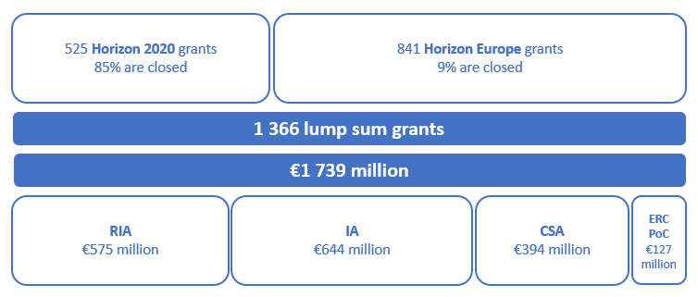
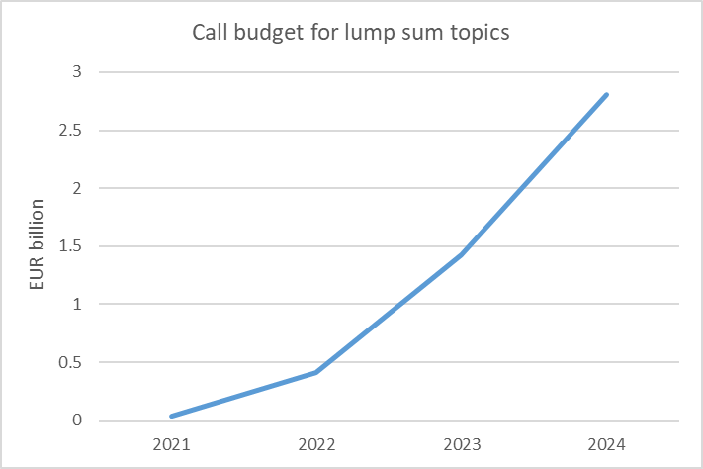
Developments up to 2024
  Signed grants
  1 366 grants signed by Jan. 2024
  EUR 1.7 billion EU contribution, mostly for RIAs, IAs, and CSAs
  Published work programmes
  EUR 4.7 billion for lump sum topics until 2024

Slide 4
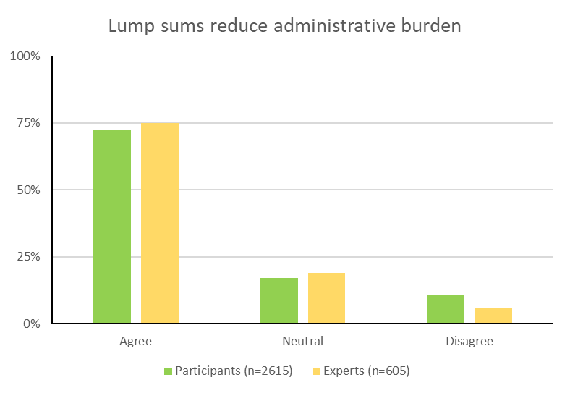
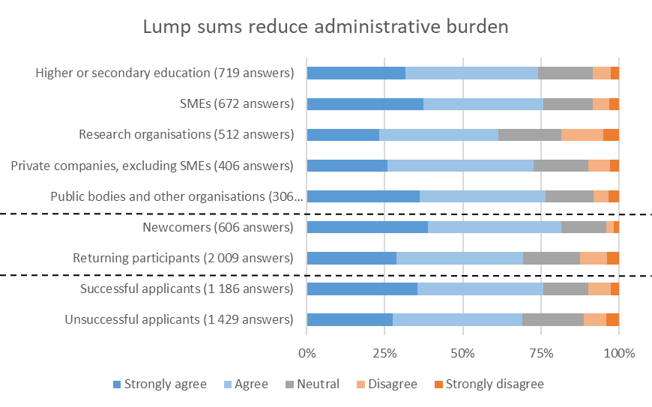
Lump sums remain popular
  2021 result confirmed in 2024
  The great majority of participants and experts agree that lump sum funding reduces the administrative burden and that it shifts the focus to the content of projects.
  SMEs and newcomers particularly positive
  This confirms the potential of lump sums to improve the access to R&I funding.

Slide 5
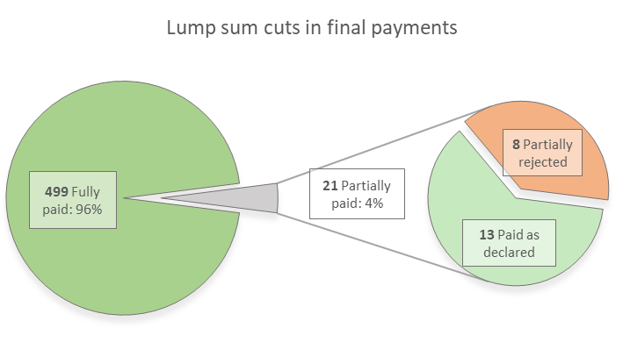
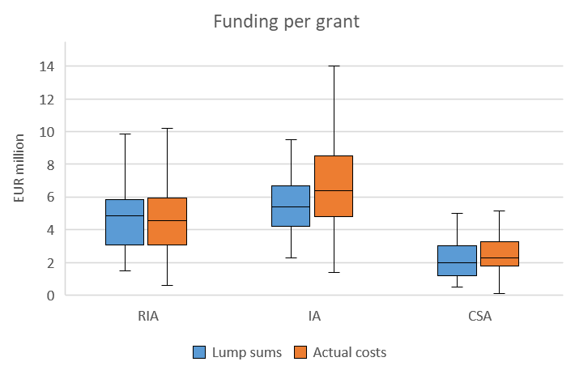
Lump sum grants do not behave differently (I)
  Most lump sum grants are paid in full
  Almost all lump sums were paid as declared
  Less than 2% were partially reduced
  Controls work
  No evidence of increased financial risk
  No change in funding
  The amount of funding is generally similar in lump sum and actual cost grants.
  So far, we avoid lump sums for very big grants. This can explain the wider range of grant sizes for actual cost IAs.

Slide 6
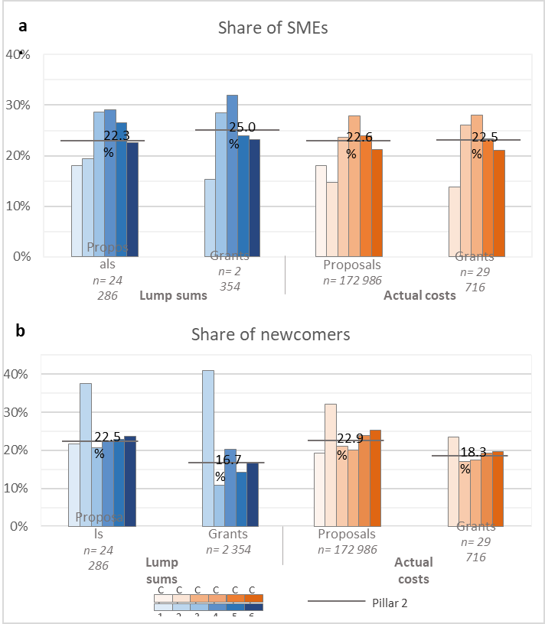
Lump sums do not behave differently (II)
  Normal levels of SMEs and newcomers
  Large variation across and within the six clusters of Pillar II
  No significant difference in the average values of SME and newcomer participations when comparing lump sums and actual costs
  The functioning of R&I projects is not changed
  All types of organisations are well represented in lump sum projects
  More work packages in lump sum grants, but the average funding per participation and per lump sum work package is still very sizeable

Slide 7
Suggested improvements
  Guidance on splitting work packages
  We have updated the proposal template to clarify how the work packages should be designed and described, and to clarify that the splitting of work packages is optional.
  User-friendliness of the lump sum budget table
  We are working towards the implementation of the lump sum budget table in the online submission system (planned for 2025), and we continue to improve the current Excel file.
  Quality of the evaluation feedback
  We have updated the briefing for experts: experts’ recommendations on the lump sum budget must be precise enough, and experts must document the assessment of the budget.
  Clarity on record-keeping and controls
  Preparations for ex-post technical reviews for lump sum grants are ongoing.
  No financial audits of lump sum grants.

Slide 8

Full report available online
  Funding & Tenders Portal, 3 September 2024
  https://ec.europa.eu/info/funding-tenders/opportunities/portal/screen/support/news/30194

Slide 9

Resources available
One dedicated lump sum page on the Funding &Tenders Portal with:
Video tutorials
Overview of lump sum funding
Guidance documents
What do I need to know? & Quick guide
Reference documents
Model Grant Agreement Lump Sum
Studies
European Commission assessment (Oct 2021)
Events
Future events
Past events and recordings
European Parliament (STOA) study on lump sums in Horizon 2020 (May 2022)
Decision authorising the use of lump sum contributions under the Horizon Europe Programme
Frequently asked questions
Detailed guidance for participants
Lump sum briefing slides for experts
Horizon dashboard for lump sum evaluations
Detailed budget table
European Commission assessment (Sep 2024)

Slide 10
Thank you!
# HorizonEU
http://ec.europa.eu/horizon-europe

